Slide 1
Organization Visiting: The Panjeree Publications
Course Name: Business Studies for Engineers
Course Code: BUS 405
Supervised by-
Mr. Md. Iftekharul Amin
Assistant Professor
Institute of Business Administration
University Of Dhaka

Slide 2
Presented by
Group-1
Md. Tahmidur Rahman Khan (BSSE0801)
Iftekhar Hossain (BSSE0802)
Tahlil (BSSE0803)

Slide 3
Presentation Outline
Aim of the project
About the Organization
Vision and the Values
Hierarchical Structure
Recruitment System
Organizational Culture
Involvement in Social Responsibility
Code of Ethics

Slide 4
Aim of the Project
To study the organizational culture
Know about the structure of an organization
Get an idea about the relationship between the manager and employees
To get better understanding about the environment of an organization

Slide 5

About the organization: The Panjeree Publications
Panjeree Publications is one of the leading publications in Bangladesh.
Started its journey in the year of 2000.
It is exceptionally popular to the people of Bangladesh, specially to the students for its quality products.

Slide 6
Vision and Values: Panjeree Publications
Vision : To provide quality educational materials to everyone and discourage piracy.
Values :
Result Driven
Liable & Transparent
Determined & Respectful
Creative & Cooperative
Focused on Readers Interest

Slide 7
Organizational Structure: The Panjeree Publications
Panjeree Publications manages its business and operations vertically through 4 distinct units namely:
Marketing Unit
Procurement Unit
Accounting Unit
MIS and Others

Slide 8
Managerial Hierarchy (Management level)
Board of
Directors
Chairman
Vice Chairman
Managing Director
Director

Slide 9
Managerial Hierarchy (Unit wise)
Marketing
Unit
Senior Executive Officer
Executive
Officer
Senior
Officer
Officer
Procurement
Unit
Procurement
Officer
Purchasing Manager
Contact
Officer
Buyer
Accounts Unit
Accounts Officer
Supporting Team
MIS and Others
Data Officer
IT officer
Risk Manager
Anti-piracy team

Slide 10
Recruitment System
In general, employees are hired through bdjobs.com
Employees with no prior experience are aptitude tested
Eligible applicants are interviewed
Successful applicants are sent offer letters

Slide 11
Orienting New Employees
All new employees are mentored by the seniors.
Current employees of the department are encouraged to hold informal workplace related discussions with new employees on topics such as goal, vision and history of the company.
New employees who struggle to cope up with the office environment are provided with the necessary training.
Current employees can informally pressurize the new employees to resign if performance is not satisfactory up to some certain level.

Slide 12
Culture of the Organization
All activities are performed maintaining the legal issues.
Expressing gratitude for work done is highly encouraged.
Greatly involved in maintaining social values.
All tasks must be approved by immediate senior
Special privileges are provided on the national important days.
All the international transactions are performed through the LC(Letter of Credit).

Slide 13
Involvement of Organization in Social Responsibility
The Panjeree Publications is highly involved in social issues.
It frequently organizes various competitions in multiple categories.
The winners of these competitions are rewarded so that they are encouraged in performing more constructive activities.
In general, national celebrities are invited to attract more people to these competitions.
It responses in the time of disasters as well.

Slide 14
Involvement of Organization in Social Responsibility
The readers are provided educational materials at the lowest possible price considering the buying capability of the mass people.
The readers also enjoy convenient environment in the Panjeree book stores.
Special arrangements like 3D/5D movie theatre delights the young learners.

Slide 15
Culture of the Organization
The organization is highly strict about reaching the workplace in time and a late more than 10 minutes is considered as a late attendance.
Following the dress code is mandatory.
The Board of directors are responsible for the final decision.
Multiple opinions and viewpoints are highly welcomed and appreciated in ambiguous issues.

Slide 16
Informal Culture of the Organization
In the birthdays of the reputed writers, their books are exhibited with special offers and they are given gifts to express gratitude.
Employees gossip among themselves whenever there is free time.
Special discount is given at nationally or internationally important days like 21st February, Halloween festival etc.

Slide 17
Code Of Ethics
The Panjeree Publications greatly emphasizes on the ethical issues.
It discourages its employees to be involved in unethical activities as well as continues a movement against piracy and other unethical deeds across the country.
New employees are trained to uphold the ethical values and follow the code of ethics.
Ethical activities are highly appreciated and unethical activities are strongly prohibited and may cause immediate punishment.

Slide 18
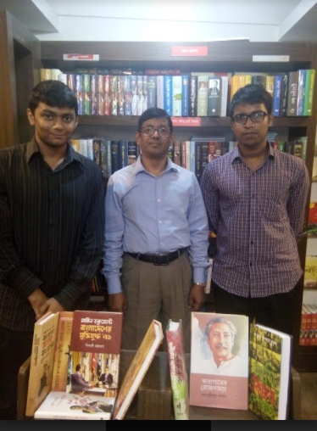
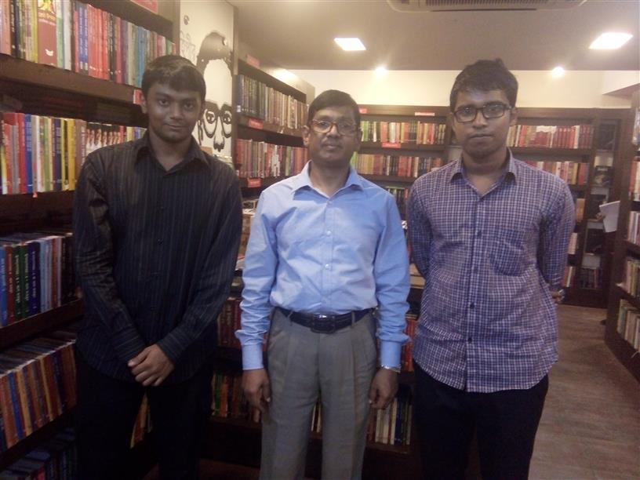
Memories. . .
With Md. Mahfuzur Rahman Khan, COO, Panjeree Book Store (PBS)

Slide 19
Thank You!

